Slide 1
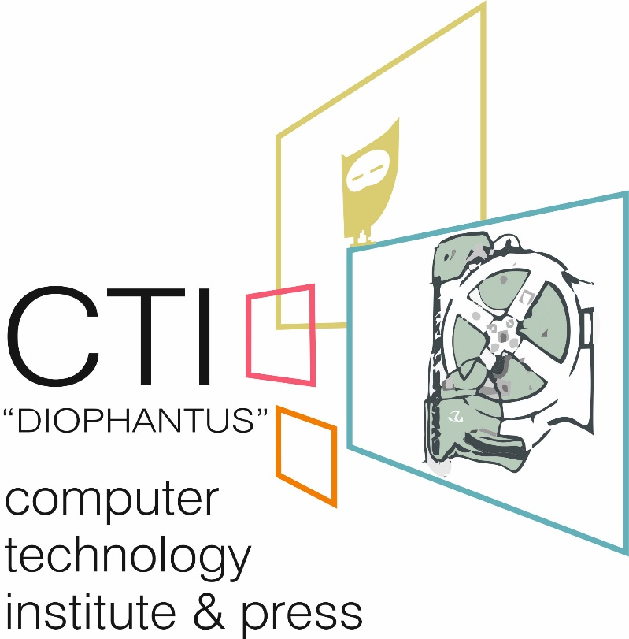
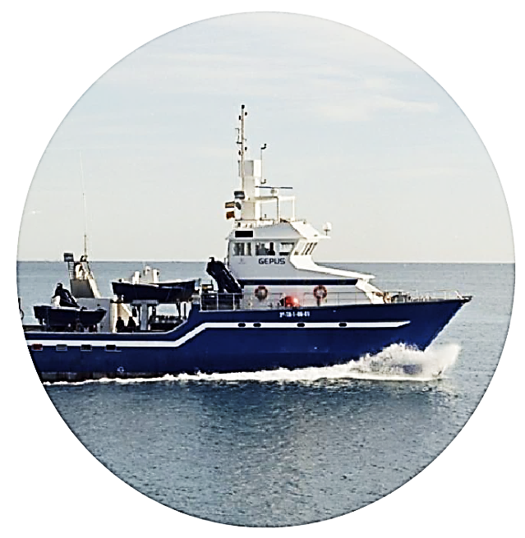
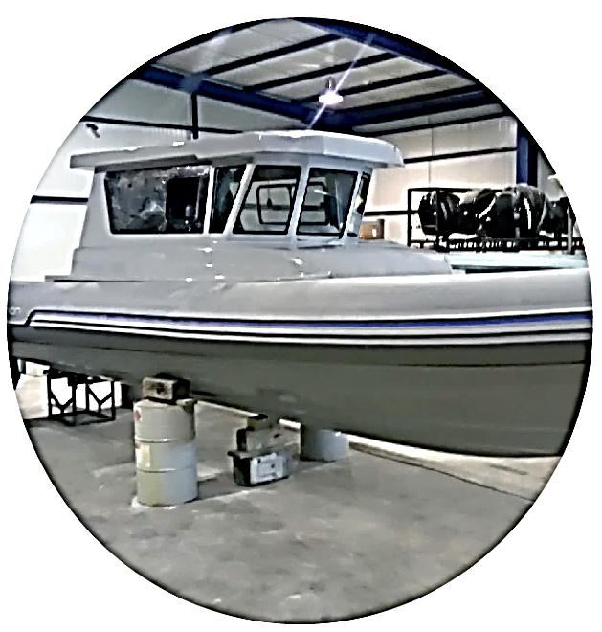
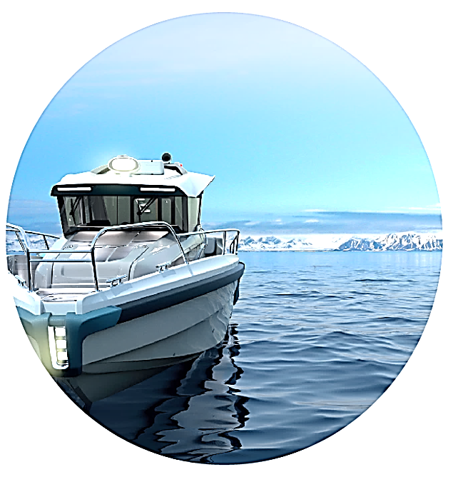
Lean Innovative Connected Vessels
The LINCOLN Project
LINCOLN Project (www.lincolnproject.eu) introduces and performes three new concepts of added-value regarding specialized vessels, able to run advanced services for several maritime sectors (Marine Aquaculture, Ocean Energy, Coastal Monitoring, Control and Surveillance, and Rescue) in the most effective, efficient, economic valuable and eco-friendly way.
To achieve its goals, LINCOLN uses innovative technologies: A lean fact-based design model approach, which combines real operative data at sea with lean methodology to support the development and implementation of vessel concepts: IT customized tools to enable the acquisition & usage of field data, an Internet of Things (IoT) platform; High Performance Computing Simulation.
So, LINCOLN will develop three types of completely new vessel concepts at TRL5:
MULTI-PLATFORM CATAMARAN
EERV VESSELS SERIES (Emergency Response & Rescue Vessels)
MODULE-BASED HIGH SPEED
PATROL BOAT PLATFORM
A service crew & Multipurpose survey vessel, optimized for Ocean duties and Aquaculture. It ensures: improved safety during people transfer; reduced operations costs; eco-friendliness.
For Coastal Rescue activities, including
integrated electronics, IoT connectivity & an enhanced, low-cost Integrated
Dynamic Position System, helping rescue operators during their activities &
enhancing safety & security.
Reconfigurable platform able to be adapted to the different operational requirements for patrol & security operators.
The role of CTI “DIOPHANTUS”
in the project
The weather application is intended to:
CTI will investigate, design and implement a Single Window application to gather weather data and information from sensors on board of vessels and/or stations located in neighbor coastal areas. These data will be automatically analyzed to produce warnings, reports and visualization services for stakeholders, such as vessels crew, coast guards, rescuers, port managers, weather services.
CTI capitalizes the results and achievements of a previous project, called ARGES. In fact, the main principles of the “Portweather” application www.portweather.eu (developed by CTI in the framework of ARGES) will be embedded to the new weather application. A modern network of gathering data and information from all types of sensors on board will be established, thus extending the operational capabilities of rescue boats and improving services.
To this end, automated modules and algorithmic procedures will analyze the initial information in order to visualize in a user-friendly environment, current conditions and short-range forecasts. The new weather application will be designed to operate using the IoT principles and philosophy.
Record/calculate marine and meteorological parameters (temperature, humidity, air pressure, wind vector, precipitation, wave height) in high temporal resolution (minute scale).
Provide descriptive statistics (mean values, standard deviations etc.) about the parameters of interest using the archive datasets (data values recorded in the two to three previous hours).
Provide estimates about the temporal evolution of selected parameters (short-range forecasting), based on Machine Intelligence Techniques (e.g. Artificial Neural Networks, Support Vector Machines).
Provide alerts and warnings about possible extreme weather events to support decision making under difficult/dangerous conditions.
This project has received funding from the European Union’s Horizon 2020 research and innovation programme under grant agreement n. 727982
Contact:
Dr Chrysostomos Stylios stylios@cti.gr, Dr Stavros Kolios stavroko@gmail.com
Computer Technology Institute & Press “DIOPHANTUS”, "D. Maritsas" Building, Nikou Kazantzaki street University Campus of Patras, 265 04 Rion

